Slide 1
Machine Learning
Chapter 05
Evaluating Hypotheses

Slide 2
Evaluating Hypotheses
Statistical methods are used for estimating hypothesis accuracy
First, given the observed accuracy of a hypothesis over a limited sample of data, how well does this estimate its accuracy over additional examples?
Second, given that one hypothesis outperforms another over some sample of data, how probable is it that this hypothesis is more accurate in general?
Third, when data is limited what is the best way to use this data to both learn a hypothesis and estimate its accuracy?

Slide 3
Evaluating Hypotheses
MOTIVATION: when we must learn a hypothesis and estimate its future accuracy given only a limited set of data, two key difficulties arise:
Bias in the estimate. First, the observed accuracy of the learned hypothesis over the training examples is often a poor estimator of its accuracy over future examples. Because the learned hypothesis was derived from these examples, they will typically provide an biased estimate of hypothesis accuracy over future examples.
Variance in the estimate. Second, even if the hypothesis accuracy is measured over an unbiased set of test examples independent of the training examples, the measured accuracy can still vary from the true accuracy, depending on the makeup of the particular set of test examples. The smaller the set of test examples, the greater the expected variance.

Slide 4
ESTIMATING HYPOTHESIS ACCURACY
When evaluating a learned hypothesis we are interested in estimating the accuracy with which it will classify future instances.
And also to know the probable error in the accuracy estimate.
There is some space of possible instances X. We assume that different instances in X may be encountered with different frequencies. There is some unknown probability distribution D that defines the probability of encountering each instance in X.

Slide 5
ESTIMATING HYPOTHESIS ACCURACY
We are interested in the following two questions:
1. Given a hypothesis h and a data sample containing n examples drawn at random according to the distribution D, what is the best estimate of the accuracy of h over future instances drawn from the same distribution?
2. What is the probable error in this accuracy estimate?

Slide 6
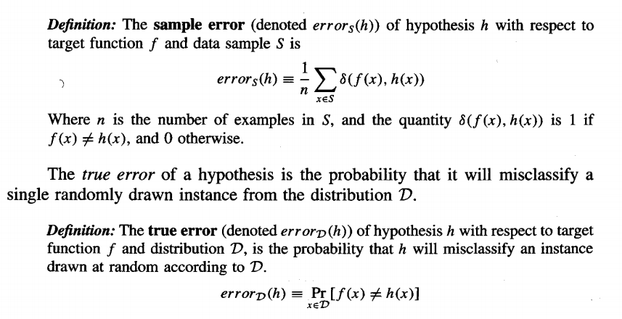
Sample Error and True Error
We need to distinguish between two notions of accuracy or, equivalently, error. One is the error rate of the hypothesis over the sample of data that is available. The other is the error rate of the hypothesis over the entire unknown distribution D of examples. We will call these the sample error and the true error respectively.
The sample error of a hypothesis with respect to some sample S of instances drawn from X is the fraction of S that it misclassifies:

Slide 7
Confidence Intervals for Discrete-Valued Hypotheses
"How good an estimate of error_{D}(h) is provided by error_{s}(h)?”
- for the case in which h is a discrete-valued hypothesis.
To estimate the true error for some discrete valued hypothesis h, based on its observed sample error over a sample S, where
the sample S contains n examples drawn independent of one another, and independent of h, according to the probability distribution D.
n >= 30
hypothesis h commits r errors over these n examples error_{s}(h) = rln

Slide 8
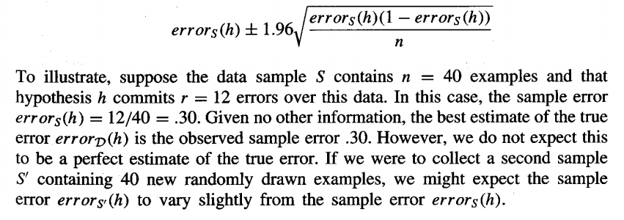
Under these conditions, statistical theory allows us to make the following assertions:
Given no other information, the most probable value of error_{D}(h) is errors(h).
With approximately 95% probability, the true error error_{D}(h) lies in the interval.

Slide 9
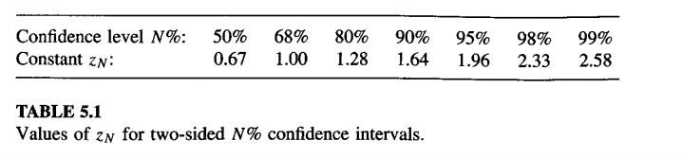
If we repeat this experiment over and over, each time drawing a new sample Si containing 40 new examples, we would find that for approximately 95% of these experiments, the calculated interval would contain the true error.
For this reason, we call this interval the 95% confidence interval estimate for error_{D}(h). In the current example, where r = 12 and n = 40, the 95% confidence interval is, according to the above expression,

Slide 10
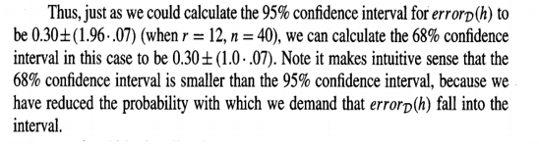

Slide 11

A more accurate rule of thumb is that the above approximation works well when
Above we summarized the procedure for calculating confidence intervals for discrete-valued hypotheses.
The following section presents the underlying statistical justification for this procedure.

Slide 12
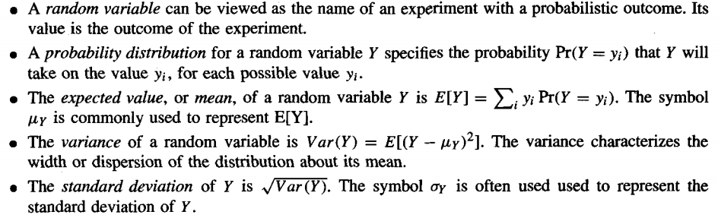
BASICS OF SAMPLING THEORY
Basic notions from statistics and sampling theory

Slide 13
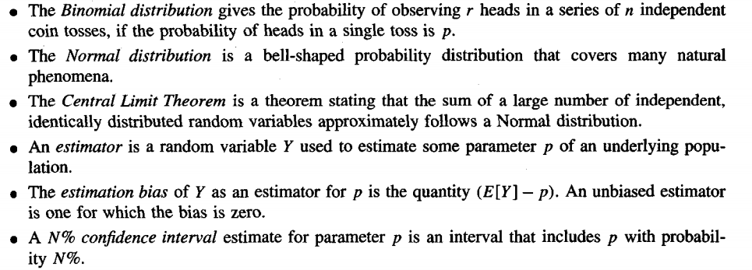

Slide 14
Error Estimation and Estimating Binomial Proportions
We first collect a random sample S of n independently drawn instances from the distribution D, and then measure the sample error error_{s}(h).
If we were to repeat this experiment many times, each time drawing a different random sample Si of size n, we would expect to observe different values for the various error_{si}(h), depending on random differences in the makeup of the various Si.
One can think of a random variable as the name of the experiment with a random outcome.
The value of the random variable is the observed outcome of the random experiment.

Slide 15
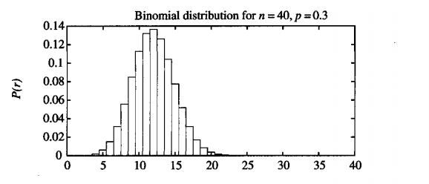
Imagine that we were to run k such random experiments, measuring the random variables errors1(h), errors2(h) . . . errorsk(h).
Imagine further that we then plotted a histogram displaying the frequency with which we observed each possible error value.
As we allowed k to grow, the histogram would approach the form of the distribution shown in Table 5.3.
This table describes a particular probability distribution called the Binomial distribution.

Slide 16
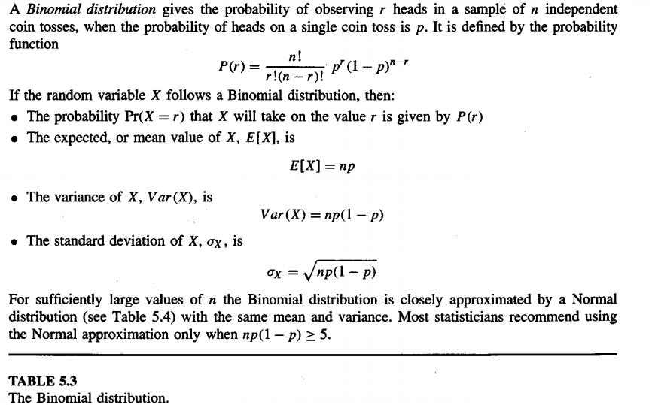

Slide 17
The Binomial Distribution
given a worn and bent coin and asked to estimate the probability that the coin will turn up heads when tossed. Let us call this unknown probability of heads p. You toss the coin n times and record the number of times r that it turns up heads. A reasonable estimate of p is rln.
if the experiment were rerun, generating a new set of n coin tosses, we might expect the number of heads r to vary somewhat from the value measured in the first experiment, yielding a somewhat different estimate for p.
The Binomial distribution describes for each possible value of r (i.e., from 0 to n), the probability of observing exactly r heads given a sample of n independent tosses of a coin whose true probability of heads is p.

Slide 18

The general setting to which the Binomial distribution applies is:
There is a base, or underlying, experiment (e.g., toss of the coin) whose outcome can be described by a random variable, say Y. The random variable Y can take on two possible values (e.g., Y = 1 if heads, Y = 0 if tails).
The probability that Y = 1 on any single trial of the underlying experiment is given by some constant p, independent of the outcome of any other experiment. The probability that Y = 0 is therefore (1 - p). Typically, p is not known in advance, and the problem is to estimate it.
A series of n independent trials of the underlying experiment is performed (e.g., n independent coin tosses), producing the sequence of independent, identically distributed random variables Y1, Y2, . . . , Yn. Let R denote the number of trials for which Yi = 1 in this series of n experiments

Slide 19

4 . The probability that the random variable R will take on a specific value r (e.g., the probability of observing exactly r heads) is given by the Binomial distribution
A plot of this probability distribution is shown in
Table 5.3.
The Binomial distribution characterizes the probability of observing r heads from n coin flip experiments, as well as the probability of observing r errors in a data sample containing n randomly drawn instances
------5.2

Slide 20
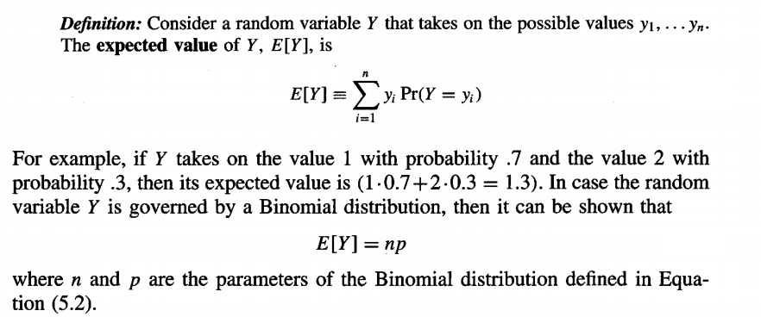
Mean and Variance
Two properties of a random variable that are often of interest are its expected value (also called its mean value) and its variance. The expected value is the average of the values taken on by repeatedly sampling the random variable.

Slide 21
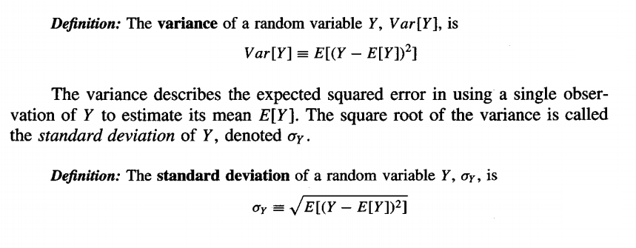
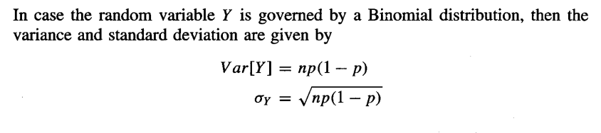

Slide 22
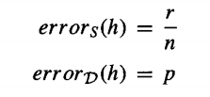
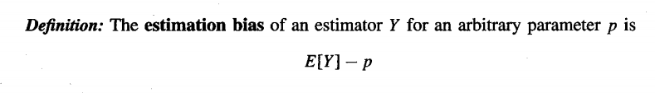
Estimators, Bias, and Variance
Now we have shown that the random variable errors(h) obeys a Binomial distribution, What is the likely difference between errors(h) and the true error errorD(h)?
Let us describe errors(h) and errorD(h) using the terms in probability Distribution defining the Binomial distribution. We then have
where n is the number of instances in the sample S, r is the number of instances from S misclassified by h, and p is the probability of misclassifying a single instance drawn from D.
We define the estimation bias to be the difference between the expected value of the estimator and the true value of the parameter.
If the estimation bias is zero, we say that Y is an unbiased estimator for p. This will be the case if the average of many random values of Y generated by repeated random experiments (i.e., E[Y]) converges toward p.

Slide 23
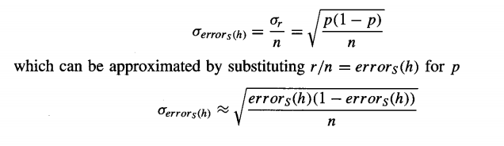
To illustrate these concepts, suppose we test a hypothesis and find that it commits r = 12 errors on a sample of n = 40 randomly drawn test examples. Then an unbiased estimate for errorD(h) is given by errors(h) = rln = 0.3.
The variance in this estimate arises completely from the variance in r, because n is a constant.
Because r is Binomially distributed, its variance is given by Equation as np(1 - p).
Unfortunately p is unknown, but we can substitute our estimate rln for p. This yields an estimated variance in r of 40*0.3(1 - 0.3) = 8.4, or a corresponding standard deviation of √8.4=2.9. This implies that the standard deviation in errors(h) = rln is approximately 2.9/40 = .07.
To summarize, errors(h) in this case is observed to be 0.30, with a standard deviation of approximately 0.07.
In general, given r errors in a sample of n independently drawn test examples, the standard deviation for errors(h) is given by
Eqn. (5.9)

Slide 24
Confidence Intervals
confidence interval estimates : The uncertainty associated with an estimate is to give an interval within which the true value is expected to fall, along with the probability with which it is expected to fall into this interval.
Definition: An N% confidence interval for some parameter p is an interval that is expected with probability N% to contain p.
For example, if we observe r = 12 errors in a sample of n = 40 independently drawn examples, we can say with approximately 95% probability that the interval 0.30 ±0.14 contains the true error errorD(h).

Slide 25
How can we derive confidence intervals for errorD(h)?
we know the Binomial probability distribution governing the estimator errors(h).
The mean value of this distribution is errorD(h), and the standard deviation is given by Equation (5.9).
to derive a 95% confidence interval, we need to only find the interval centered around the mean value errorD(h), which is wide enough to contain 95% of the total probability under this distribution.
This provides an interval surrounding errorD(h) into which errors(h) must fall 95% of the time.

Slide 26
for the Binomial distribution this calculation are quite tedious.
based on the fact that for large sample sizes the Binomial distribution can be approximated by the Normal distribution.

Slide 27
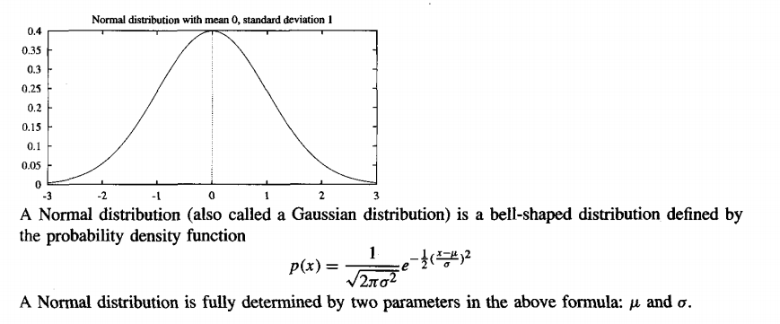
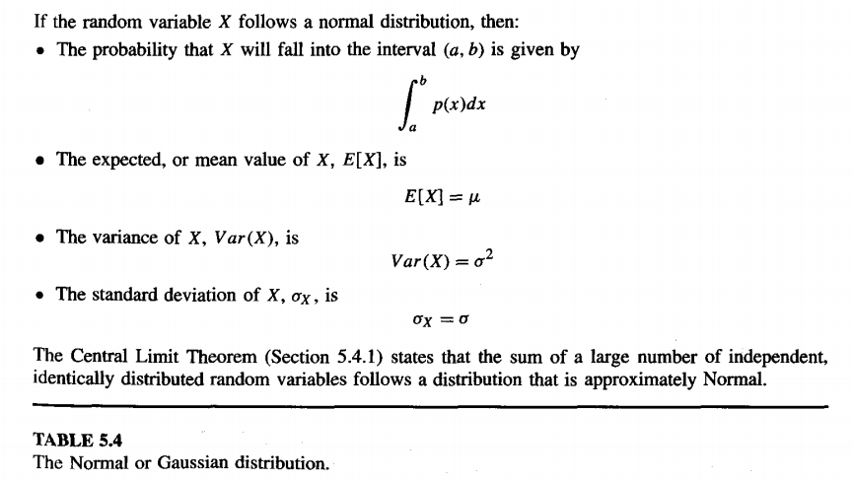

Slide 28
The constant Z_{N} given in Table 5.1 defines the width of the interval about the mean
that includes N% of the total probability mass under the bell-shaped Normal distribution.
More precisely, Z_{N} gives half the width of the interval (i.e., the distance from the mean in either direction) measured

Slide 29


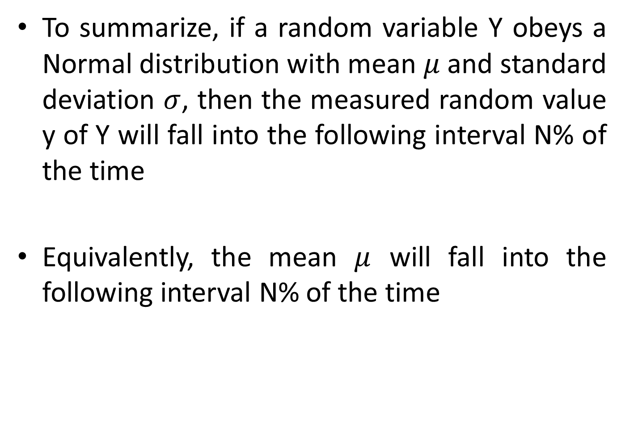
To summarize, if a random variable Y obeys a Normal distribution with mean $μ$ and standard deviation $σ$, then the measured random value y of Y will fall into the following interval N% of the time
Equivalently, the mean $μ$ will fall into the following interval N% of the time
Eqn. (5.10)
Eqn. (5.11)

Slide 30

To derive the general expression for N% confidence intervals for discrete-valued hypotheses given in Equation (5.1).
First, we know that errors(h) follows a Binomial distribution with mean value error_{D}(h) and standard deviation as given in Equation (5.9).
Second, we know that for sufficiently large sample size n, this Binomial distribution is well approximated by a Normal distribution.
Third, Equation (5.11) tells us how to find the N% confidence interval for estimating the mean value of a Normal distribution.
Substituting the mean and standard deviation of errors(h) into Equation 5.11
yields the expression from Equation (5.1) for N% confidence intervals for discrete-valued hypotheses.
Two approximations were involved in deriving this expression, namely:
we have approximated errorD(h) by errors(h) and
The Binomial distribution has been approximated by the Normal distribution.

Slide 31
Two-sided and One-sided Bounds
the above confidence interval is a two-sided bound; it bounds the estimated quantity from above and from below. In some cases, we will be interested only in a one-sided bound.
Any two-sided confidence interval based on a Normal distribution can be converted to a corresponding one-sided interval with twice the confidence.
That is, a 100(1- α )% confidence interval with lower bound L and upper bound U implies a 100(1- α/2)% confidence interval with lower bound L and no upper bound.
It also implies a 100(1- α/2)% confidence interval with upper bound U and no lower bound.
Here α corresponds to the probability that the correct value lies outside the stated interval.
In other words, α is the probability that the value will fall into the unshaded region in Figure 5.l(a), and α/2 is the probability that it will fall into the unshaded region in Figure 5.l(b).

Slide 32
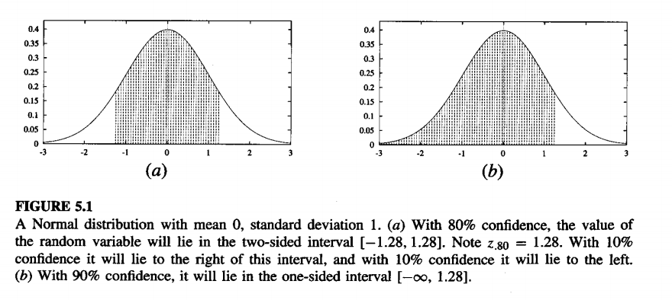

Slide 33
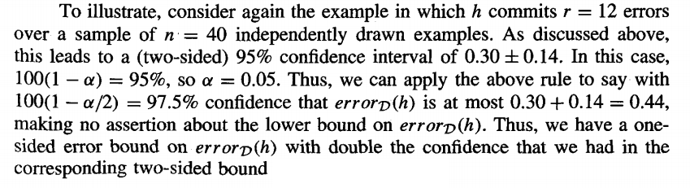
Example

Slide 34
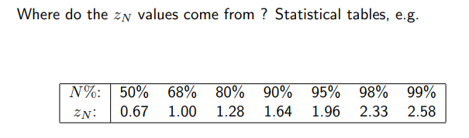
Exercise 1 Hypothesis h misclassifies 12 of the 40 examples in S errorS(h) = 12/40 = .30 What is errorD(h)?
Evaluating Hypothesis

Slide 35
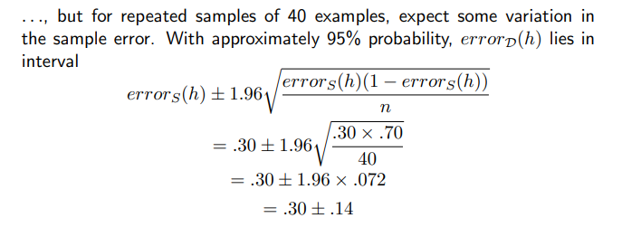

Slide 36
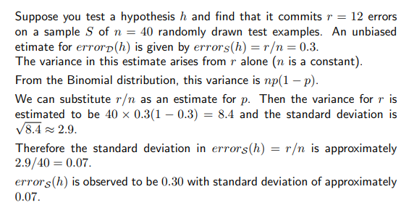
Exercise 2

Slide 37
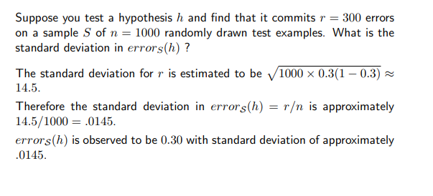
Exercise 3

Slide 38
Exercise 4 Consider a learned hypothesis, h, for some boolean concept. When h is tested on a set of 100 examples, it classifies 83 correctly. What is the standard deviation and the 95% confidence interval for the true error rate for Error _{D} ( h )?

Slide 39
17 / 100 | = | 0.17
100 ( 0.17 )( 1 - 0.17 ) | = | 14.11
square root ( 14.11 ) | = | 3.76
3.76 / 100 | = | 0.0376
 | = | standard deviation estimate for Error _{D} ( h )
95% confidence interval for Error _{D} ( h ) =
 | Error _{D} ( h ) +- 1.96 * ( square root [ Error _{D} ( h ) * ( 1 - Error _{D} ( h ) ) / n ] )
 | = |  | 0.17 +- 1.96 ( square root [ 0.17 * ( 1 - 0.17 ) / 100 ] )
 | = |  | 0.17 +- 0.0736

Slide 40
Exercise 5 Suppose hypothesis h commits r = 10 errors over a sample of n = 65 independently drawn examples.
1. What is the 90% confidence interval (two-sided) for the true error rate?
10 / 65 | = | 0.15
90% interval | = | 0.15 +- 1.64 ( square root [ 0.15 * ( 1 - 0.15 ) / 65 ] )
 | = | 0.15 +- 0.073

Slide 41
2. What is the 95% one-sided interval (i.e., what is the upper bound U such that error_{D}(h) <= U with 95% confidence)?
100(1-α) =90 α = 0.1 100(1-0.1/2) =95 upper bound | = | 0.15 + 0.073
 | = | 0.223
3. What is the 90% one-sided interval?
80% two sided interval | = | 0.15+- 1.28 (square root [0.15 * (1 - 0.15 ) / 65] )
 | = | 0.15 +- 0.056
90% upper bound | = | 0.15 + 0.056
 | = | 0.206
100(1-α/2) =90
α = 0.2
100(1-0.2) =80

